Slide 1

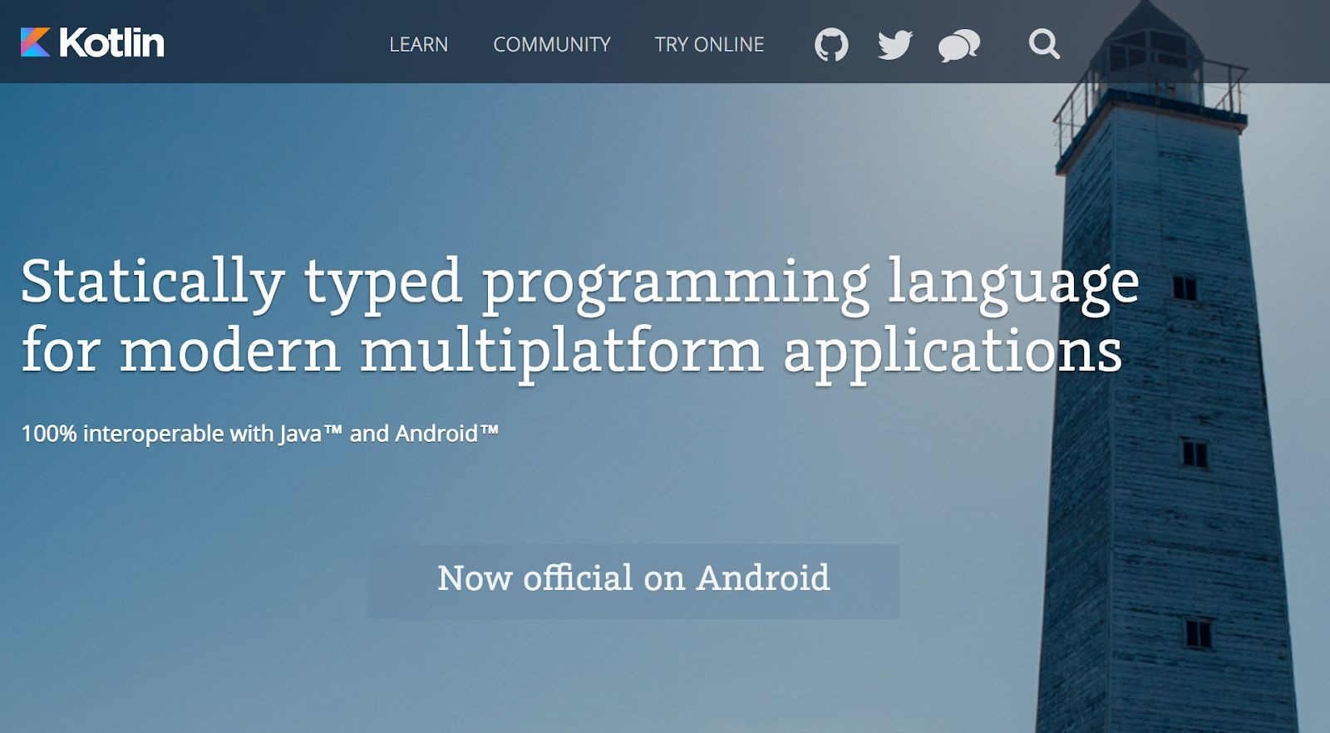

Kotlin
Kotlin is named after an island in the Gulf of Finland.

Slide 2
Why Kotlin ?
Kotlin
Server-side development.
Full-stack web development.
Multiplatform mobile development.
Data science.

Slide 3
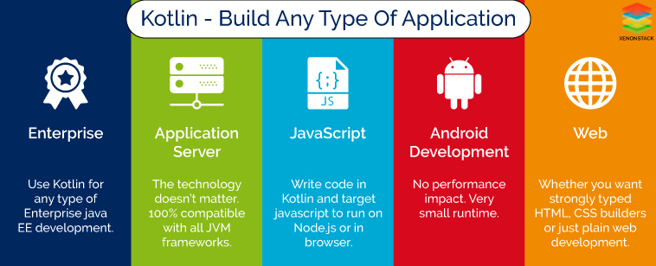
Why Kotlin

Slide 4
Benefits of Kotlin
Interoperability.
Safety & Clarity.
Tooling support.
Community support
Kotlin is an open-source

Slide 5
The history of Kotlin
Kotlin was developed by JetBrains in 2010.
They initially released it under the name Project Kotlin in July 2011.
JetBrains open-sourced the project under the Apache 2 license in February 2012.
Kotlin v1.0 was released on February 15, 2016.

Slide 6
The history of Kotlin
At Google I/O 2017, Google announced first-class support for Kotlin on Android.
On 2019, Google announced that the Kotlin programming language is now its preferred language for Android app developers.

Slide 7




Logo

Slide 8
Software installation on windows
Java JDK(For Kotlin).
https://download.oracle.com/java/22/latest/jdk-22_windows-x64_bin.exe (sha256)
Installation intellij IDEA.
https://www.jetbrains.com/idea/download/?section=windows.

Slide 9
Hello, world!
fun main(args: Array<String>) {
println("Hello, world!")
}
fun main() {
println("Hello, world!")
}
fun main() = println("Hello, world!")
Where is “;”???

Slide 10
The basics
fun main(args: Array<String>) { print("Hello")
println(", world!")
}
An entry point of a Kotlin application is the main top-level function.
It accepts a variable number of String arguments that can be omitted.
print prints its argument to the standard output.
println prints its arguments and adds a line break.

Slide 11
Variables
val/var myValue: Type = someValue
var - mutable
val - immutable
Type can be inferred in most cases
Assignment can be deferred
val a: Int = 1
/ immediate assignment
var b = 2 b = a
/ 'Int' type is inferred
/ Reassigning to 'var' is okay
val c: Int c = 3
a = 4
/ Type required when no initializer is provided
/ Deferred assignment
/ Error: Val cannot be reassigned

Slide 12
Variables
const val/val myValue: Type = someValue
const val - compile-time const value
val - immutable value
for const val use uppercase for naming
const val NAME = "Kotlin" / can be calculated at compile-time
val nameLowered = NAME.lowercase() / cannot be calculated at compile-time

Slide 13
Functions
fun sum(a: Int, b: Int): Int { return (a + b)
}
fun myFunction(x:Int, yInt): Int
{
return (x + y)
}
fun main() {
var result = myFunction(3, 5) println(result)
}
Single expression function.
Unit means that the function does not return anything meaningful.
It can be omitted.
Arguments can have default values.
fun mul(a: Int, b: Int) = (a * b)

Slide 14
If expression
fun maxOf(a: Int, b: Int): Int { if (a > b) {
return a
} else {
return b
}
}
is the same as
fun maxOf(a: Int, b: Int) = if (a > b) {
a
} else {
b
}
if can be an expression (it can return).
Can be a one-liner:
fun maxOf(a: Int, b: Int) = if (a > b) a else b

Slide 15
When expression
when (x) {
1 > print("x = 1")
2 > print("x = 2") else > {
print("x is neither 1 nor 2")
}
}
when returns, the same way that if does.
when {
x < 0 > print("x < 0") x > 0 > print("x > 0") else > {
print("x = 0")
}
}
The condition can be inside of the branches.

Slide 16
When statement
fun serveTeaTo(customer: Customer) { val teaSack = takeRandomTeaSack()
when (teaSack) { is OolongSack
> error("We don't serve Chinese tea like $teaSack!")
in trialTeaSacks, teaSackBoughtLastNight >
error("Are you insane?! We cannot serve uncertified tea!")
}
teaPackage.brew().serveTo(customer)
}
when can accept several options in one branch. else branch can be omitted if when block is used as a
statement.

Slide 17
&& vs and
if (a & b) { . } VS if (a and b) { . }
Unlike the & operator, this function does not perform short-circuit evaluation.
The same behavior with OR:
if (a | b) { . }
VS
if (a or b) { . }

Slide 18
Loops
val items = listOf("apple", "banana", "kiwifruit")
for (item in items) { println(item)
}
for (index in items.indices) {
println("item at $index is ${items[index]}")
}
for ((index, item) in items.withIndex()) { println("item at $index is $item")
}

Slide 19
Loops
val items = listOf("apple", "banana", "kiwifruit")
var index = 0
while (index < items.size) {
println("item at $index is ${items[index]}") index +
}
var toComplete: Boolean do {
.
toComplete = .
} while(toComplete)
The condition variable can be initialized inside to the do…while loop.

Slide 20
Loops
There are break and continue labels for loops:
myLabel@ for (item in items) {
for (anotherItem in otherItems) { if ( .) break@myLabel
else continue@myLabel
}
}

Slide 21
Ranges
val x = 10
if (x in 1 .10) { println("fits in range")
}
for (x in 1 .5) { print(x)
}
for (x in 9 downTo 0 step 3) { print(x)
}
downTo and step are extension functions, not keywords.
' .' is actually T.rangeTo(that: T)

Slide 22
Null safety
val notNullText: String = "Definitely not null" val nullableText1: String? = "Might be null" val nullableText2: String? = null
fun funny(text: String?) { if (text = null)
println(text)
else
println("Nothing to print :(")
}
fun funnier(text: String?) {
val toPrint = text : "Nothing to print :(" println(toPrint)
}

Slide 23
Elvis operator :
If the expression to the left of : is not null, the Elvis operator returns it; otherwise, it returns the expression to the right.
Note that the expression on the right-hand side is evaluated only if the left-hand side is null.
fun loadInfoById(id: String): String? { val item = findItem(id) : return null
return item.loadInfo() : throw Exception(" .")
}

Slide 24
Safe Calls
someThing .otherThing does not throw an NPE if someThing is null.
Safe calls are useful in chains. For example, an employee may be assigned to a department (or not). That department may in turn have another employee as a department head, who may or may not have a name, which we want to print:
fun printDepartmentHead(employee: Employee) { println(employee.department .head .name)
}
To print only for non-null values, you can use the safe call operator together with let:
employee.department .head .name .let { println(it) }

Slide 25
Unsafe Calls
The not-null assertion operator ( !) converts any value to a non-null type and throws an NPE exception if the value is null.
fun printDepartmentHead(employee: Employee) { println(employee.department !.head !.name !)
}
Please, avoid using unsafe calls!

Slide 26
TODO
Always throws a NotImplementedError at run-time if called, stating that operation is not implemented.
/ Throws an error at run-time if calls this function, but compiles fun findItemOrNull(id: String): Item? = TODO("Find item $id")
/ Does not compile at all
fun findItemOrNull(id: String): Item? = { }

Slide 27
String templates and the string builder
val i = 10
val s = "Kotlin"
println("i = $i")
println("Length of $s is ${s.length}")
val sb = StringBuilder() sb.append("Hello") sb.append(", world!") println(sb.toString())

Slide 28
Thanks!

